Slide 1
Evidence-Oriented Programming
Andreas Stefik, Ph.D.
Assistant Professor
Department of Computer Science
University of Nevada, Las Vegas
http://web.cs.unlv.edu/stefika/
http://quorumlanguage.com/
@AndreasStefik

Slide 2
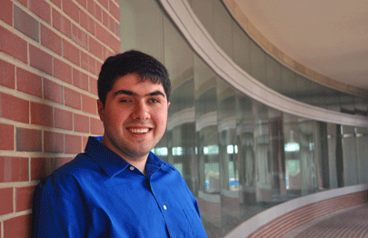
So in 2006 or so …
I was a Ph.D. student investigating computer audio applications
During this time, I met a number of programmers on the Internet
These individuals happened to be blind
Sina Bahram
White House Champion of Change
Prime Access Consulting
https://pac.bz/

Slide 3
I was curious …
Some obvious questions came to mind …
How hard is to program blind?
How hard it is to debug programs blind?
Can you use all of the modern editor features blind (e.g., code completion, editor hints, code folding, block languages)?
I talked first to professional blind programmers
Blind programming seemed incredibly difficult
So then I thought, if it’s so hard, even for professionals, how hard is it for children that want to get in the discipline?

Slide 4

So I started talking to blind children and teachers of the visually impaired
I watched blind children try to program in C
Key Observation: For blind children, programming was hard. Really … really … really … hard.
EPIQ
2015

Slide 5

Programming blind was hard for many reasons
Maybe* I can fix some of these problems
C-style syntax was hard to understand through audio (e.g., for left paren int i equals zero semicolon i less than 10 semicolon i plus plus right paren)
Debuggers were practically or actually worthless for the blind
Features in a development environment almost never worked properly in audio or had wacky designs when translated to audio
There were no educational programs, anywhere in the United States, for blind children to learn to program
* Ultimately, they gave me a Ph.D. for inventing a talking debugger and showing evidence that it helped.

Slide 6
But understanding C in audio was still very hard
I had this nagging question in my head, “What is the evidence for the design decisions in C?”
So, I tried to look up all the human factors data on languages
Except, I found something … unexpected
The Programming Language Community
was not gathering evidence
Proofs? ✔
Performance Data? ✔
Human Factors Data? ✖
Quick Detour on the history of evidence gathering regarding human subjects.

Slide 7
A Quick Primer on the History of Evidence Gathering on Humans
This part of the talk was brought to you largely by this paper:
Kaptchuk, Ted. Intentional Ignorance: A History of Blind Assessment and Placebo Controls in Medicine. Bulletin of the History of Medicine, 72.3 (1998) 389 – 433.
http://media.virbcdn.com/files/5f/FileItem-260254-Kaptchuk_IntentIgnor_BulHisMed1998.pdf

Slide 8
There are approximately 5 semi-distinct historical phases
Phase 1: Fraud Detection
Late 18th Century
Use sham treatments (no randomization, no experimental control)
Phase 2: Beginning of Blind Assessment
Mid 19th Century
Sham, single/double blind (no randomization, no experimental control)
Phase 3: Birth of Psychology
Late 19th Century
Sham, single/double blind, basic randomization begins (no control)

Slide 9
As science progressed in other fields, so did experimentation
Phase 4: Pharmacology Research
Up until approximately 1930
Birth of formal experimental designs, Randomization controversial, Blind/Double blind, Placebo more formalized
Phase 5: The Beginning of Randomized Controlled Trials (RTC)
Started in the mid 1930s, but especially after World War II
Heavily Influenced by Fisher, Randomization formalized, experimental designs required by mainstream science in most disciplines
Trends today (not from Kaptchuk)
Re-thinking statistical practices to help increase the likelihood of replication
Registration of Randomized Controlled Trials
Significant knowledge of competing styles of experiments and their pros/cons

Slide 10
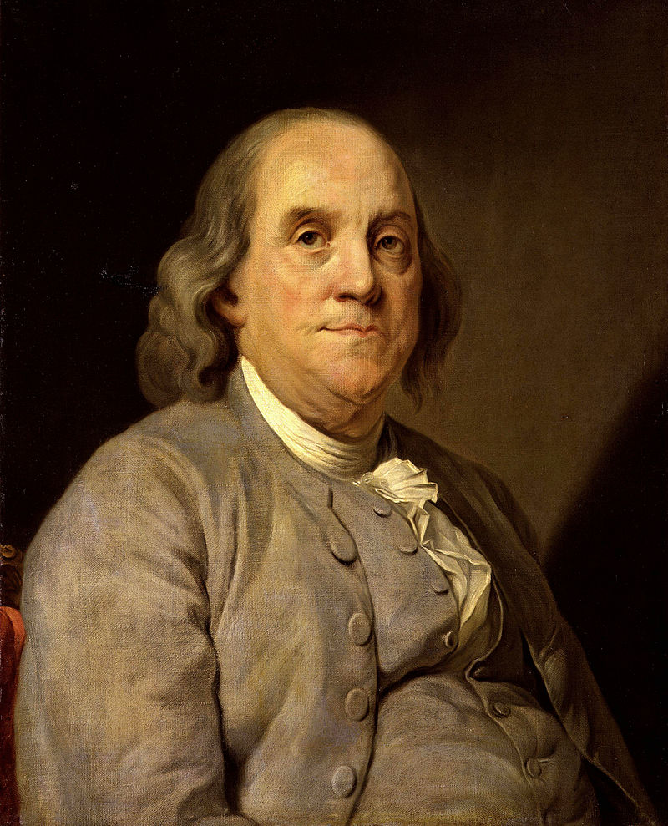
In the first phase, experiments exposed quackery and fraud
Take Mesmerism … (animal magnetism)
Louis the XVI formed a commission to evaluate:
Whether the methods analyzed had “real” force
Explicitly excluded “non-physical” arguments
Led by Benjamin Franklin
How do we know it is quackery? Use sham treatments
Scientists already had the answer, yet the medical community debated whether the “experiments were good enough” for nearly a century

Slide 11
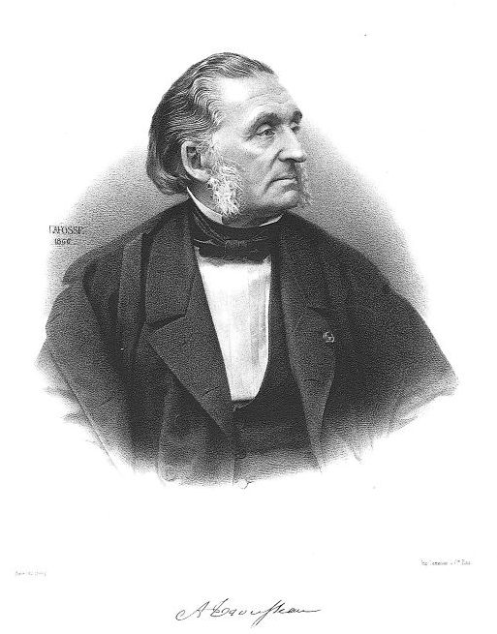
What about homeopathy?
Hahnemann argued for “Similia similibus curentur” or “like cures like”
Many investigations have taken place, including early ones like:
Armand Trousseau (1801 - 1867) and his students using bread pills (Placebo, 1834, negative result)
Double blind by 1879-80 (Milwaukee Academy of Medicine – inconclusive result)
Does homeopathy stand up to scrutiny? No!
Homeopathy has been thoroughly, unendingly debunked, yet the UK still funds it today

Slide 12
Sensation, psychics, and talking to the dead
As we moved toward Phase 3, the field of Psychology was beginning, studying things like:
Differences in weight that people could sense (Pierce and Jastrow, 1883)
Psychics (e.g., can you pull a card at random from a deck and psychically tell another person?) (Richet, 1884)
Other experiments on esoteric supernatural claims
These experiments introduced randomization, again to guard against quackery, fraud, and bias

Slide 13
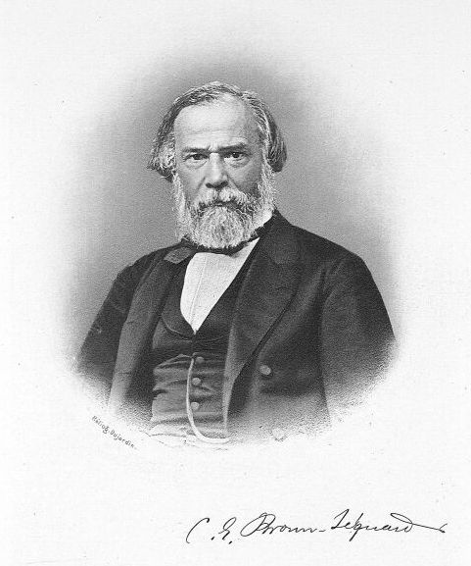
By phase 4, pharmacology pushed us forward
This phase started in part because Charles Edouard Brown-Sequard (1817 – 94) claimed that animal testicle extract would “rejuvenate physical and mental health”
Many in the medical community wanted “case histories”
In contrast, many were skeptical
The first blind assessments happened a few months after the announcement
In France: 1889 (M.G. Variot)
Germany (e.g., Fritz Pregel) now with various Placebos (e.g., saline, bread pills)

Slide 14
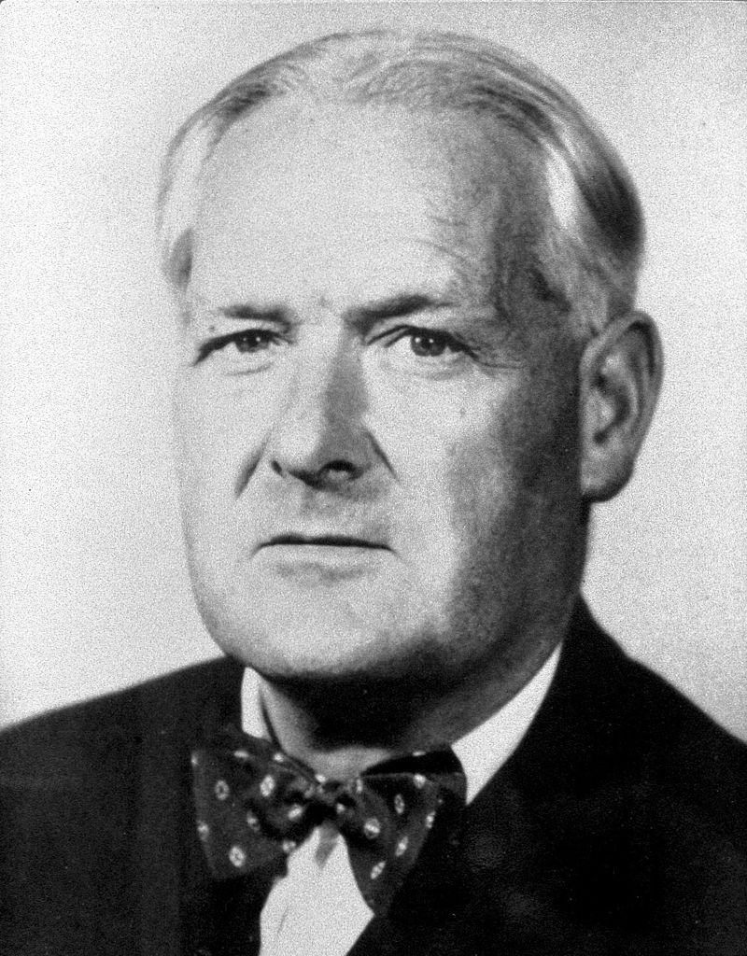
Phase 5: The beginning of randomized controlled trials
By 1935, Fisher coined his famous work, “the Design of Experiments.” This caused a seismic shift in thinking.
Randomization was controversial at the time
Journal of AMA wrote in 1955, that treatments should be “[kept] in the hands of the general practitioner and not … [be] on the basis of experiments” (corrections Kaptchuk’s)
The first actual randomized controlled trial was done by Austin Bradford Hill (1897 – 1991). He did not use the words “randomization” or “random sampling” in the paper because he was concerned he would scare off his colleagues in the field …

Slide 15
Key Observation:
Scientists over time have increased their evidence standards to avoid bias, fraud, and other issues, settling on Randomized Controlled Trials as the gold standard.
But back to programming languages and … evidence-oriented programming.

Slide 16

Where is the data?
Recap so far:
I was investigating programming tools for the blind and visually impaired. They were hard to use and I wanted to make them easier
Tools were helping, but only so much.
C seemed difficult to “hear” in audio
But … I could find very little evidence on the human factors impact of programming languages themselves, for any user (blind or not)
So, I recruited a team and began searching
Was I just not finding the evidence?
Are language designers collecting data?
Where is the data?

Slide 17
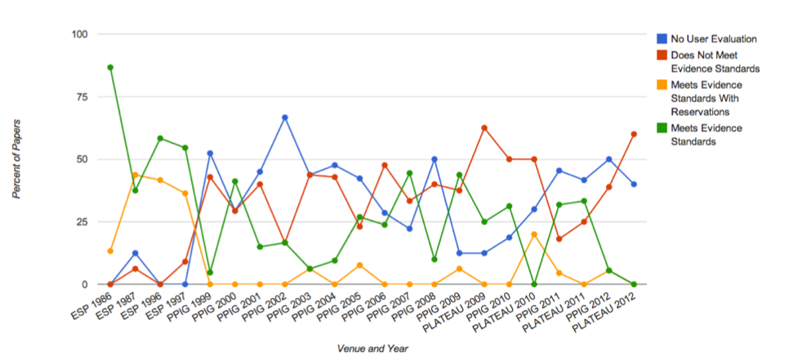
There was (nearly) no evidence – language designers were using anecdotes
We often code scholarly papers from the literature, documenting:
Did an author have evidence about language design?
Did it follow standard scientific conventions (e.g., it had a control group)?
To-date, we have coded approximately 2,200 papers in the language conferences
Key Observation: Anecdotal evidence is ill suited to a task as complex as understanding the programming language wars

Slide 18
So we* created Evidence-Oriented Programming
This new paradigm has several unique attributes:
Design features of a language must have corresponding evidence from appropriately constructed Randomized Controlled Trials
The language authors must allow the external community to suggest changes according to the scientific method, inspired by lessons from history
Evidence from other techniques (e.g., software repository mining, educational data) if gathered from humans and rigorous is allowed
My wife and I then invented Quorum (Funded by the National Science Foundation): to my knowledge, the first, and only, programming language to use a scientific evidence standard for human factors.
*By “we” I especially include Stefan Hanenberg (A German scholar that independently came to the same conclusions at the same time).

Slide 19
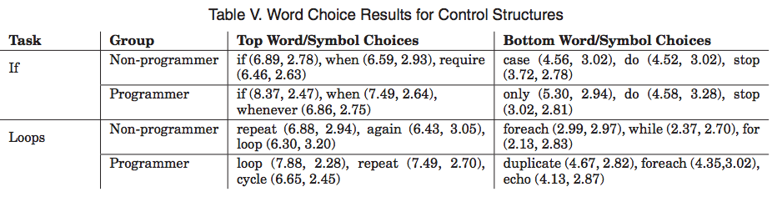
Let’s discuss how we choose our syntax/semantics
Loop syntax in Quorum looks like this:
repeat 10 times
output “Hello, World”
end
Can you figure out what that does?
Approach: Start with surveys to get a big picture view of the alternative choices in the language.
All features must be surveyed before going into Quorum.

Slide 20
Evidence-oriented programming is a paradigm, not a language
Sometimes the data is unclear, just like in other disciplines:
check
number result = 12 / 0
detect e
output e:GetErrorMessage()
end
With exceptions, a variety of issues need more evidence
Whether exceptions are helpful in a language
Which words best imply the concepts to the greatest number of people possible
The exact structure of the code

Slide 21
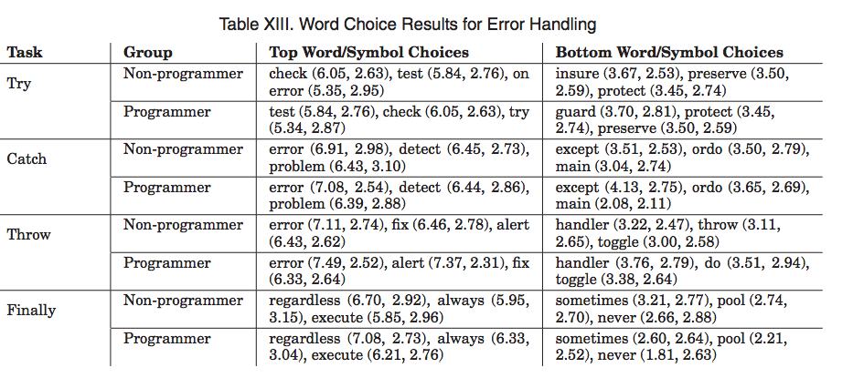
Exceptions: an example where the data is unclear

Slide 22
Knowing the history, we then used Sham Treatments
Next let’s have people actually program
Use sham treatments (placebo languages)
Test people across the spectrum (e.g., young, old, experienced, novice)
Use a statistical procedure to determine which tokens or combinations of tokens cause an impact
This is called “Token Accuracy Mapping”
It sounds weird, but the technique comes from reading DNA sequences
Result: Novices can use the programming languages Java and Perl no better than a language generated randomly from the ASCII table.
Sham treatments and randomized controlled trials provide us a way to objectively evaluate observations, as historical lessons say should be the case.

Slide 23
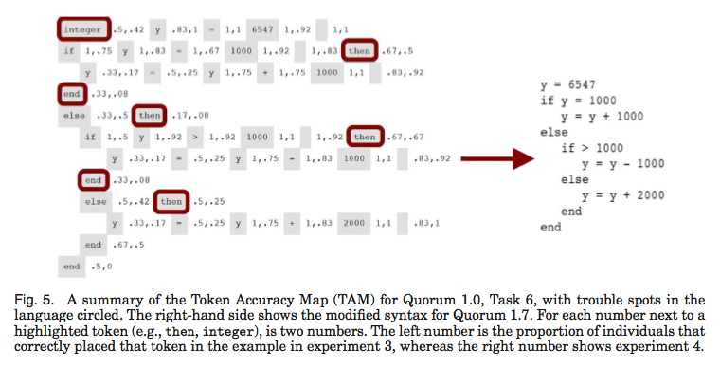
Why do we observe this*?
Token Accuracy Maps tell us which tokens cause problems
* This does not just mean novices: Programmers' Build Errors: A Case Study (at Google) Hyunmin Seo, Caitlin Sadowski, Sebastian Elbaum, Edward Aftandilian, and Robert Bowdidge, Hong Kong University of Science and Technology, China; Google, USA; University of Nebraska-Lincoln, USA, ICSE 2014

Slide 24
What about type systems?
Quorum’s type system is a collection of compromises, all of which are based on data (although there are holes!)
The randomized controlled trials on this show:
Once you hit approximately year 3 of a computer science program, static typing helps
For novices, they have a “small, but non-zero” negative impact
This would imply, if this theory is correct, that somewhere there must be a drop, where human factors complications with type systems start declining

Slide 25
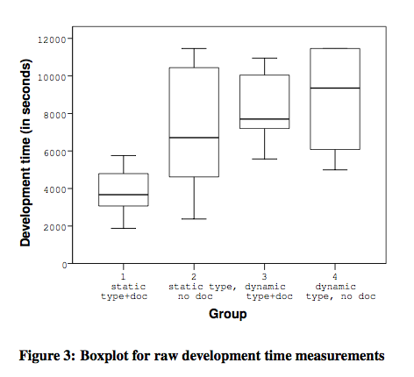
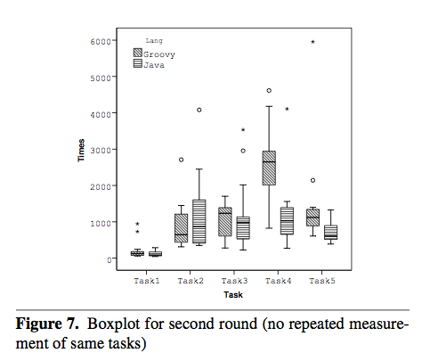
Static typing* affords greater human productivity
ICSE 2014
OOPSLA 2012
*In this context, we are referring to static typing where the annotations are made explicit.

Slide 26
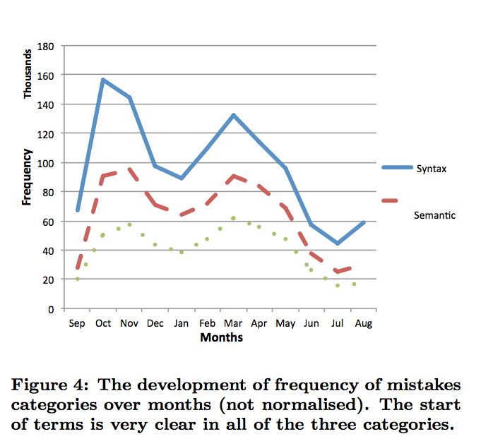
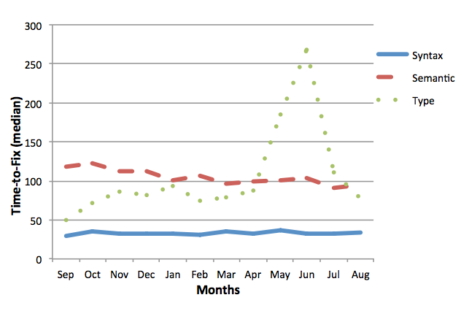
If we do software repository mining, is this theory supported?
Altadmri and Brown collected 37 million compiler errors
The results from and independent group appear to plausibly fit
Amjad Altadmri and Neil C.C. Brown. 2015. 37 Million Compilations: Investigating Novice Programming Mistakes in Large-Scale Student Data. In Proceedings of the 46th ACM Technical Symposium on Computer Science Education (SIGCSE '15). ACM, New York, NY, USA, 522-527. DOI=10.1145/2676723.2677258 http://doi.acm.org/10.1145/2676723.2677258. Figures posted with permission from the author.

Slide 27
Let’s look at an “action” in Quorum
Needs More Research
Assignment not allowed. RCTs say this matters
action GetClassesSortedInPackage(text packageKey) returns Array<Class>
HashTable<text, Class> pack = packages:GetValue(packageKey)
if pack = undefined
return undefined
end
Array<Class> sorted
Iterator<Class> cl = pack:GetValueIterator()
repeat while cl:HasNext()
Class next = cl:Next()
sorted:Add(next)
end
sorted:Sort()
return sorted
end
We allow limited Generics,
guided by Hanenberg
and Parnin’s research
PascalCase, not
Under_Score
Bind points need types,
but some inference on the
inside of actions is allowed.
No one knows how much
inference should be allowed
Use words/symbols
derived from surveys/TAMs

Slide 28
What about other systems?
Here are a few more examples of areas that have been studied in the literature:
Inheritance: Very little research (e.g., Tichy) and needs considerably more study. Results are somewhat inconclusive, but interesting.
Compiler Errors: A number of research groups have been looking at the structure of compiler errors and their impact on developers (both professionals and students: Result: it matters!)
Concurrency: There is a small number of papers on the use of transactional memory vs. Thread models.
From our list of thousands of papers, Quorum takes all of this research into account, even though I’m barely scratching the surface in this talk
Features on Quorum are generally not integrated unless a foundation of evidence is present

Slide 29
Why should we care?
Programmers should care:
There is solid evidence these issues impact productivity (read: time, money)
There is solid evidence that language designers are not following historical scientific norms for human factors
Teachers should care:
There is solid evidence these issues impact students
Languages change all the time, costing time and money for educational institutions
Businesses should care:
Productivity costs businesses money
The language wars may be costing industry significant capital
Key Consideration:
As programming languages change, or as you use particular technologies, consider carefully whether the designer is following historical scientific norms used throughout science.
If they are not, is this costing you or your organization time or money?

Slide 30

Consider a “thought experiment” on cost
Suppose developers lost 51 hours per year
Bureau of Labor Statistics says the average software developer makes $44.88/hour
http://www.bls.gov/ooh/computer-and-information-technology/software-developers.htm
How much would this cost businesses per year?
10 Developers: $22,888.80
10,000 Developers: $22,888,800
I imagine this “back of the napkin estimate” is too conservative, not taking into account:
Training time as languages change
Paying for new materials (e.g., books, conferences)
Developers may lose more than an hour per week
Key Consideration:
While not intended as a serious economic analysis, productivity issues may be very expensive for industry.

Slide 31

Thanks for listening!
Want to contribute? These things would help:
Help us flesh out Quorum’s standard Library
Do a small project in Quorum and provide us feedback from the field so we can listen and improve
Apply to the Experience Programming in Quorum (EPIQ) workshop and learn more
Quorum is a JVM language with a variety of support libraries, including the ability to call down to the JDK/other languages.
If you are interested in language designs based on evidence, check out the Quorum project:
www.quorumlanguage.com

